Slide 1
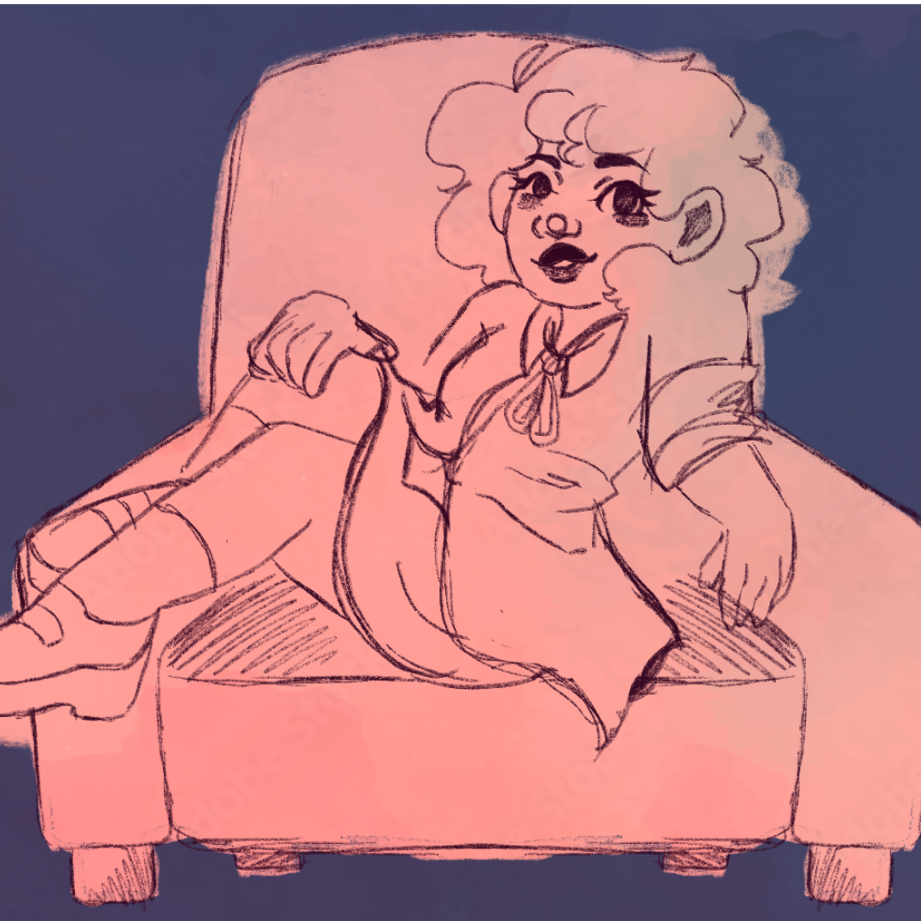
The Scoop:
A True Crime Podcast
* Probably sponsored by better help or factor or something

Slide 2
Plot
Amira, a true crime podcaster with a weak stomach is running out of cases to report that the billions of other podcasters haven’t already done. So she decides to make her own, by becoming the biggest thief of the modern day and reporting on her own crimes. Her crime of choice? Stealing animals from Petco to give them a better life.
Plot

Slide 3
Plot
Beginning
Amira struggling to find cases, goes to petco to look at fish to get inspo and thinks about how interesting a petco criminal would be
Middle
Little montage of her figuring out how to do the crime and get away with it

Slide 4
Plot
End
She commits the crime successfully. The cops come to question her and she’s in the clear. Ends with her walking into her secret room full of pets behind a bookshelf

Slide 5
Amira

Slide 6
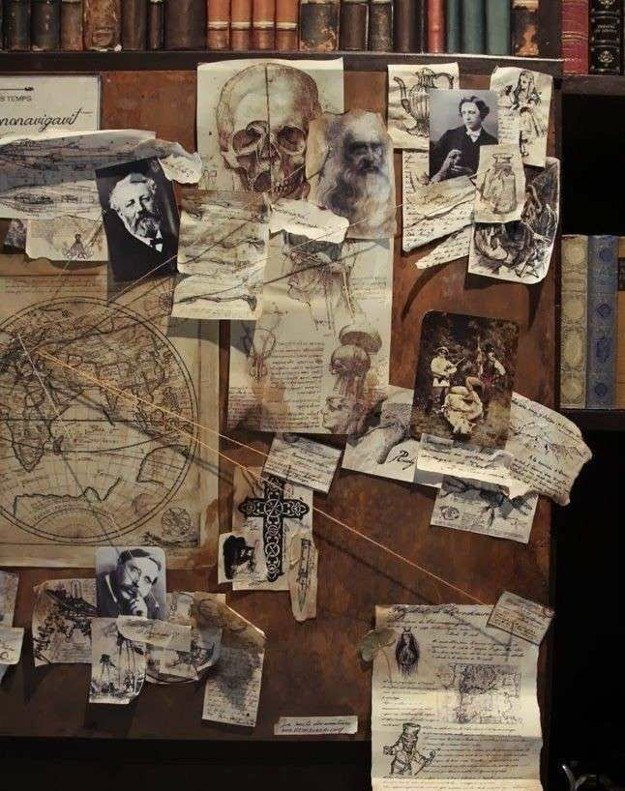
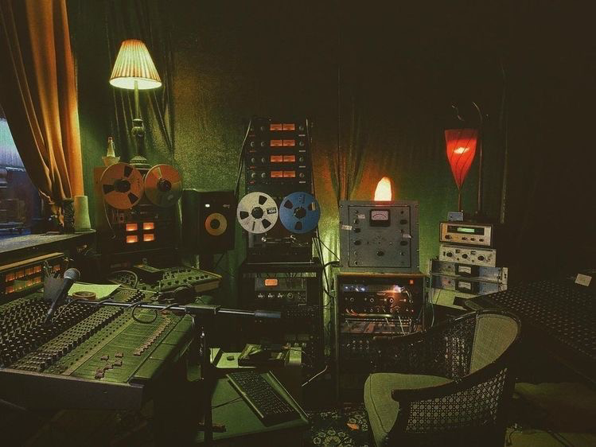
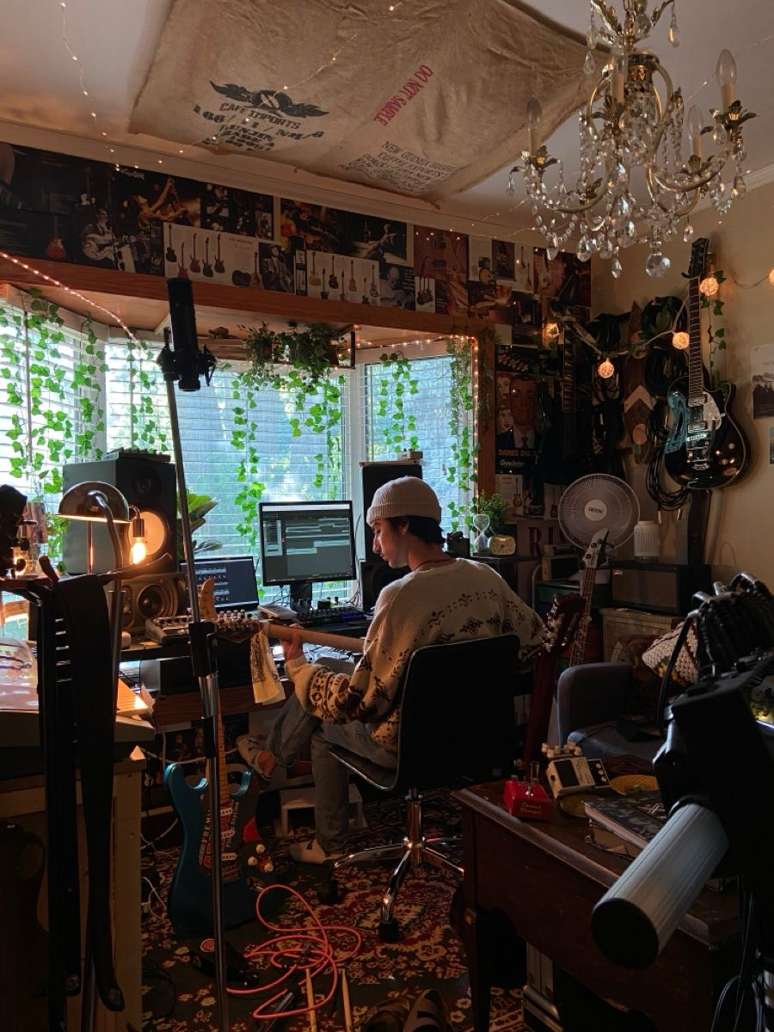
Podcast studio

Slide 7
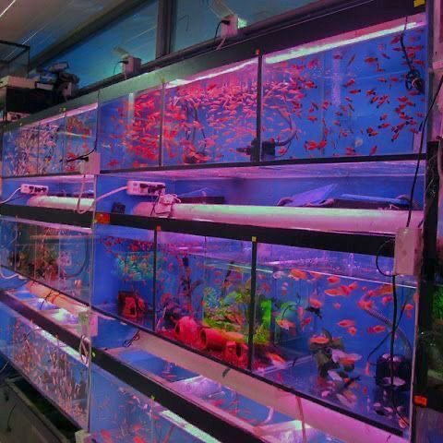
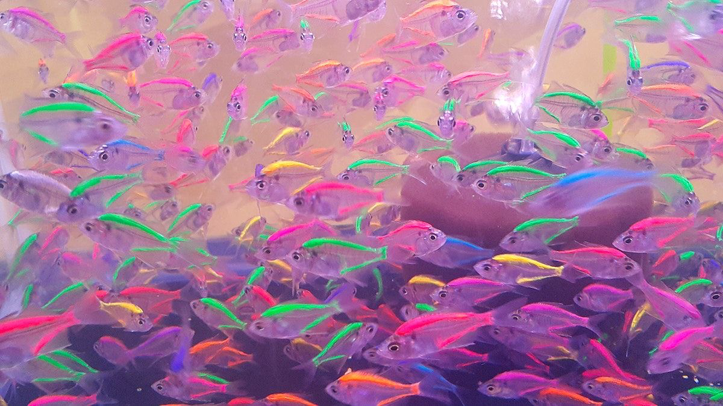
Pet store/ hidden room

Slide 8
Other inspo.

